Slide 1
Club 12 of Collin County
A non-profit journey

Slide 2
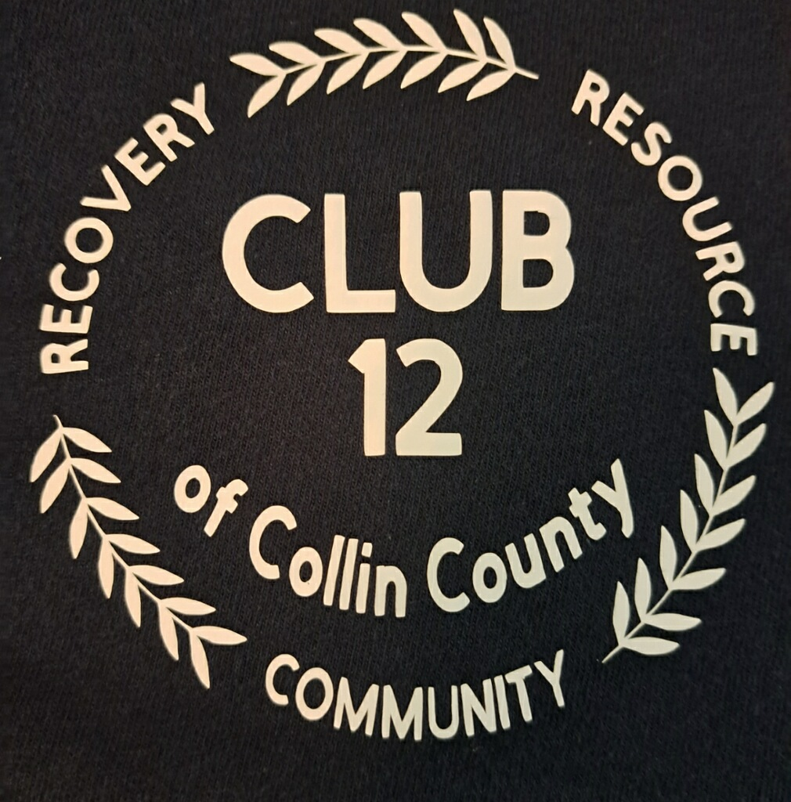
Introduction
Three fold endeavor… non-profit Recovery Community Center
A facility for 12 Step groups to have an economically consistent place to meet autonomously.
A place for those in recovery to enjoy social events (free from alcohol and drugs) with other people in recovery and their families.
Be an information resource center for the professional and public community for those in need.
Notes:
We are a nonprofit corporation dedicated to providing a safe and secure gathering place for recovering alcoholics, addicts and their families.
Three fold endeavor… non-profit Recovery Community Center
A facility for 12 Step groups to have an economically consistent place to meet autonomously.
A place for those in recovery to enjoy social events (free from alcohol and drugs) with other people in recovery and their families.
Be an information resource center for the professional and public community for those in need.

Slide 3
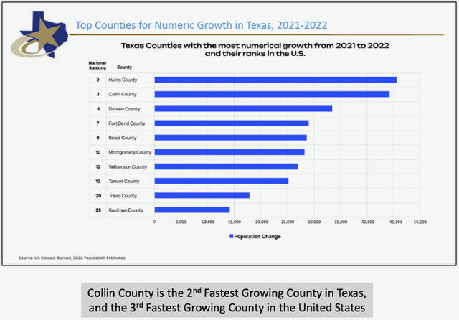
WHY?
Collin County is the 2nd Fastest Growing County in Texas, and the 3rd Fastest Growing County in the United States.
Notes:
WHY?

Slide 4
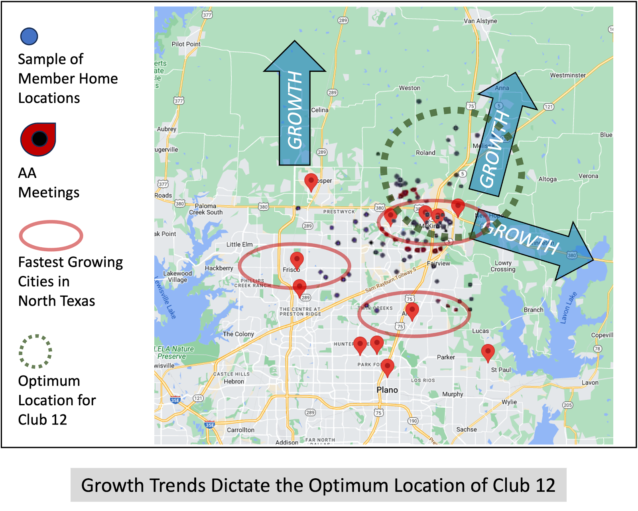
Unprecedented population growth creates a recovery gap in the North Dallas area.
Notes:
The arrows indicate the direction of growth in Collin County
The ellipses indicate the fastest growing cities in Collin County
Blue dots are where existing AA members reside
Green circle is the optimum location based on the projected growth of Collin County

Slide 5
82 Meetings per week in the North McKinney area
Collin County Group | Number Weekly AA Meetings* | Number Weekly Alanon Meetings* | Number Weekly NA Meetings*
McKinney Miracle Group | 20 | 2
McKinney Fellowship | 21 | 3
Melissa Area | 3 | X
Van Alstyne | 5 | 1
Open Door Group | 3 | X
Groupo El Milagro De McKinney | 6 | 3
Pockets of Enthusiasm | 3 | X
Sisters In Sobriety | 2 | X
Virgina Parkway Group | 3 | X
McKinney NA Meetings |  |  | 7
Total | 66 | 9 | 7
Insert Stonebridge Group and any others not shown then re-total meetings
List “Source” in small italics

Slide 6
Why do we need another meeting place?
A majority of groups rely on churches for meeting space but size and access often leaves the church in control.
Group growth is hampered as additional meeting times and space are needed. Special events accommodations may not be available.
More church campuses are becoming non-smoking.
Fellowship before and after the meeting can be impacted by church policy
There are 12 Step groups that lease commercial space:
  Financial group burdens of rising cost of commercial property with long term lease
  Additional responsibilities; security deposit, build-out cost, facility maintenance cost, occupancy permits, furnishings, parking requirements
Club 12 of Collin County’s purpose is “Not To Replace any of these groups! Rather, it is to Enhance them and any new group with permanent and affordable space
Club 12 relieves groups of the additional responsibilities associated with facility requirements

Slide 7
Our efforts are to support 12 Step Groups within Club 12 of Collin County. Here are our solutions:
We provide an affordable option to multiple recovery groups in one location.
In order to provide a facility for multiple groups;
  Club 12 is a 501-C3 corporation, that can raise funds (i.e. grants, donations, fundraising, memberships etc.) to offset expenses normally incurred by each group in a church or commercial facility.
  Groups will continue to contribute a portion of their 7th Tradition to the facility.
  Club 12 will eliminate additional facility management burdens that groups are typically responsible for that may divert them from their primary purpose.

Slide 8

Club 12 of Collin County’s purpose is “Not To Replace any of these groups!”
  Rather, it is to enhance existing and new 12 Step groups with permanent and affordable space in one easy access location, should they determine to be a part of Club 12 of CC.

Slide 9
Our efforts are to support 12 Step Groups within Club 12 of Collin County to meet their primary purpose. Here are our solutions
The 12 Step groups we intend to support include, but are not limited to the following:
    Alcoholics Anonymous – AA
    Narcotics Anonymous – NA
    Cocaine Anonymous – CA
    ALANON
    Spanish AA
    Codependents Anonymous
    Sex Anonymous
    Gambling Anonymous
Insert each Groups Service Triangle or design by each 12 Step Group
They continue operating within their 12 Step Traditions, concepts and guiding principles, allowing them to fully operate autonomously.

Slide 10
Social Events
Holiday Events
Dinner / Dancing / Entertainment
Hosting of Regional / Area 12 Step Gatherings
Cookoffs
Festivals
Circuit Speakers

Slide 11
Information Resource Center
1 out of 10 people who suffer from addiction do not know where to go for help.
Detox centers
Transitional living facilities
Social Services
12 Step meeting contacts

Slide 12

Support Club 12
“How can I be of maximum service to my fellows?”
Join our service committees:
  Developmental Planning
  Event Planning / Fundraising
  Membership
  Technology
  Public Relations
  Grant Research / Grant Writer
  Facility Planning
  Non-profit Financial / CPA

Slide 13
Britt Ford – President
Joe Lindsay – Vice President
Larry Johnson – Secretary
Liza Barstad – Treasurer
Matthew Barstad – Development
Contact Information
Phone: 469-288-8683
admin@club12ofcc.org

Slide 14
Why the different groups?
Why the different groups?
Alcoholism is the most prevalent of the illnesses in Collin County
Due to the primary purpose of each of the groups, there is a distinction in the recovery methodology.
Although the 12 Step Program of recovery is similar between groups, one group is not necessarily competent to assist the other due the difference in each other’s afflictions

Slide 15
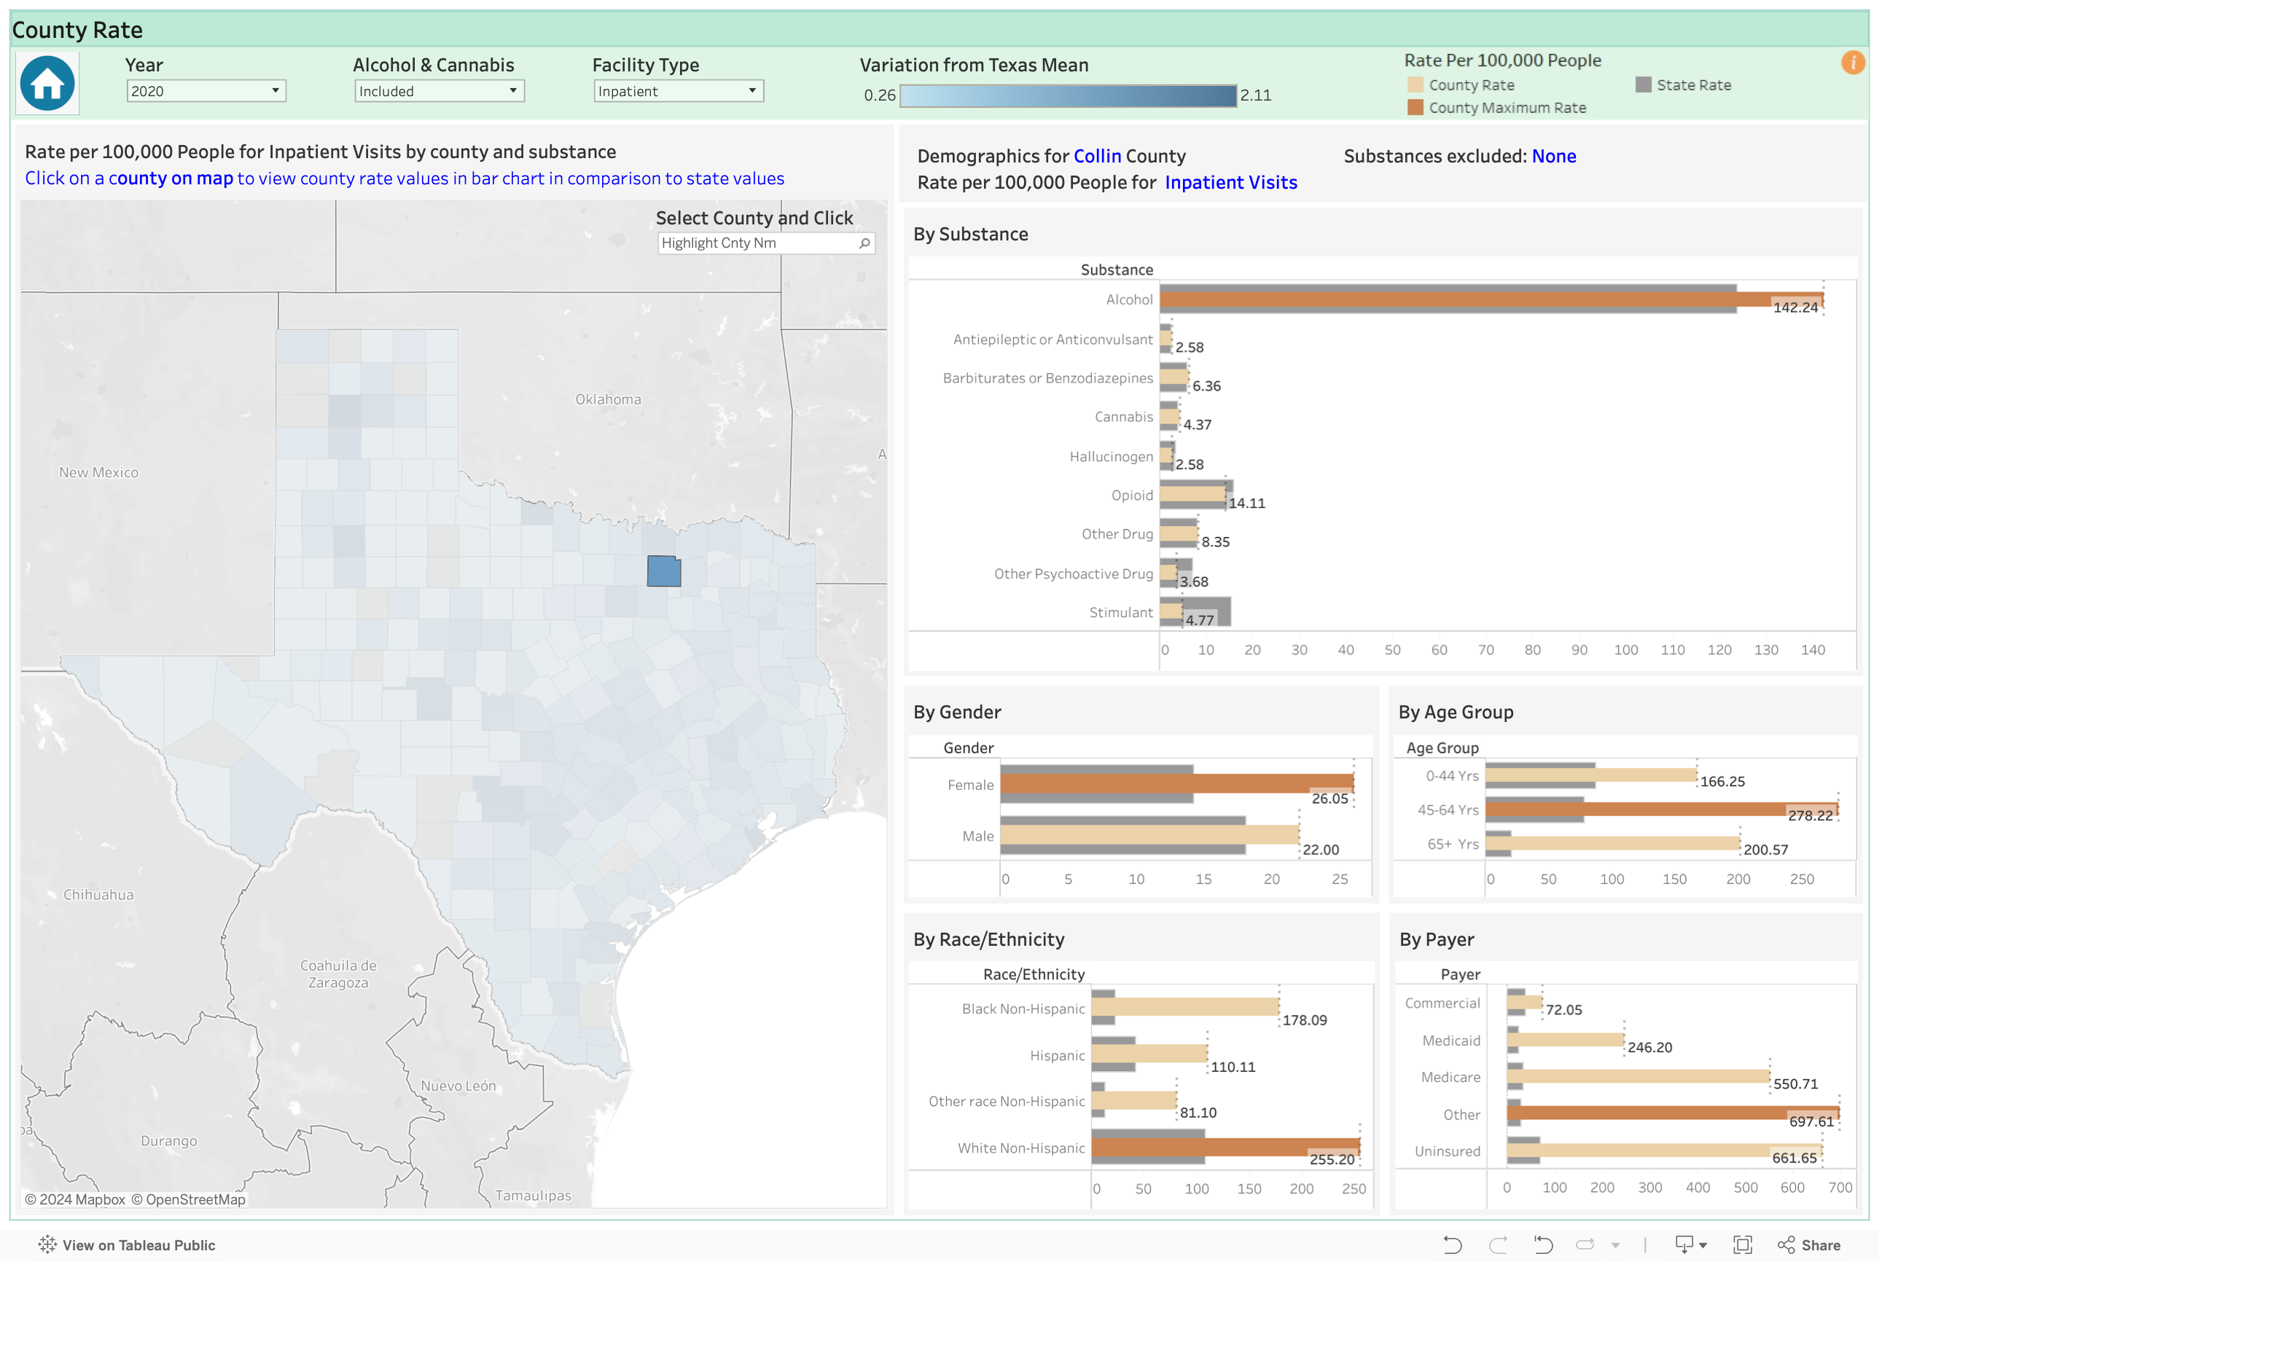
Add the Collin county addictions data for hospitals
List “Source” in small italics
Addictions Data by County - Each is Hospital Inpatient visits per 100,00 Population

Slide 16
Club 12 Service Capability
Club 12 will provide a communal facility for alcoholics, addicts and their Alanon or Alateen families that is conducive to achieving physical and emotional sobriety for people in our community.
Try to imagine the impact on family members and coworkers who have been affected by a single alcoholic or addict
Who do you know that has been impacted in your immediate circle of family and friends?
Fly in: Who Do you…
Insert individual Star Bursts in animation drop the previous starburst when the next comes in: Suicide, jails and prisons, injury or death to others, ravaged families, etc.

Slide 17
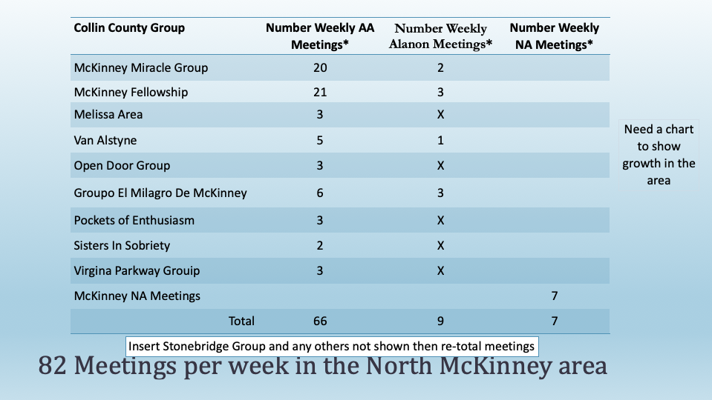
What purpose and who do we affect?
Club 12 of Collin County’s purpose is
“Not To Replace any of these groups!
Rather, it is to Enhance them and any new group
with permanent and affordable space
in one easy access location, should they determine to
be a part of Club 12 of CC

Slide 18

Our Strengths
Financial benefits to the Collin County community
  Reduction in relapse. One of the most obvious causes of relapse (returning to alcohol life or drugs) is that alcoholics and addicts do not have or know of easy access to a safe, nonjudgmental facility
There are a number of facilities in the Collin County area that host multiple recovery groups
  Small meetings are impacted by lack of control of the facility due to owner requirements
  Not all provide a consistently welcoming environment
  Some are located in areas that are not well lit or well maintained
Look at what Britt sent

Slide 19
This is what Britt sent.
Cost‐effectiveness studies
In three studies, AA/TSF had higher healthcare cost savings than outpatient treatment, CBT, and no AA/TSF treatment. The fourth study found that total medical care costs decreased for participants attending CBT, MET, and AA/TSF treatment, but that among participants with worse prognostic characteristics AA/TSF had higher potential cost savings than MET (moderate‐certainty evidence).
Authors' conclusions
There is high quality evidence that manualized AA/TSF interventions are more effective than other established treatments, such as CBT, for increasing abstinence. Non‐manualized AA/TSF may perform as well as these other established treatments. AA/TSF interventions, both manualized and non‐manualized, may be at least as effective as other treatments for other alcohol‐related outcomes. AA/TSF probably produces substantial healthcare cost savings among people with alcohol use disorder.
List “Source” in small italics – cited material
Show payee info – what 3 studies

Slide 20
Our Strengths
Club 12 is being positioned to give autonomy to smaller meetings
  Club 12 will provide an affordable place supported through 7th Tradition group contributions and donations
  The number of members of each group would determine how much each would be able to contribute
  Use bullets from Britt for the grant
There are a number of facilities in the Collin County area that host multiple recovery groups but lack the resources that Club 12 can provide
  Small meetings are impacted by lack of control of the facility due to facility owner requirements
  Not all provide a consistently welcoming environment
  Some are located in areas that are not well lit or well maintained
  Escalating Costs

Slide 21
Next Steps
Year 1 Goals:
  Define the AA Recovery need
  Research, develop, analyze funding requirements, fund and initiate the recovery based program platform
  Develop the program to provide the 12 Step solution through Club 12
  Enhance recovery community understanding and clear misinformation
  Secure operational space with growth in mind
  Establish an online presence
  Define club membership and benefits
  Establish by-laws, 501 C-3 status, and legalities

Slide 22
Next Steps
Year 2 Goals:
  Review operations and optimize community services
  Explore value of ownership vs continued rental/lease of a facility
    Stability and long term viability
  Strategic planning for sustainable growth
    Fundraising strategy
  Financial clarity
  Execute property acquisition or construction plan

Slide 23
Planning and Development Support
What is the ask from you? In a word… Support! (We do not seek money however you can join Club 12 membership and write off any donations)
We need a Development Planner to assist with:
  Business Planning
  Monetary planning
  Research
  Networks
Capabilities:
  Grant Writer with marketing experience. An investment in market research is an investment in our success!
  Facilities Planner with experience in people services

Slide 24
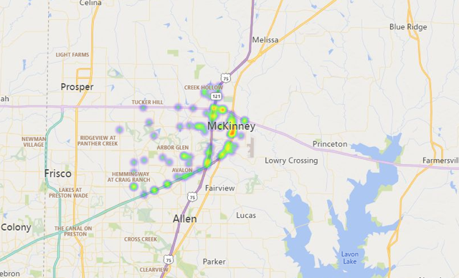
Recovery Opportunities
Unprecedented population growth creates a recovery gap in the North Dallas area.
Population growth brings increased numbers of people predisposed to addictions.
Notes:
MADD source information

Slide 25
Recovery Opportunities
Unprecedented population growth creates a recovery gap in the North Dallas area.
Population growth brings increased numbers of people predisposed to addictions.
Notes:
MADD source information

